Slide 1
Week 7, 8, 9: Dynamic Programming
CS 5800
Dr. Alan Jamieson

Slide 2
What’re we talking about today, Alan?
Dynamic Programming Paradigm
A better Fibonacci
Edit distance
Knapsack
Floyd-Warshall
A little extra (if time): Wimer method (not on the synthesis)

Slide 3
Dynamic Programming
Technique solving small subproblems and then constructing a larger, more complex problem.

Slide 4
Dynamic Programming
Technique solving small subproblems and then constructing a larger, more complex problem.
WAIT A MINUTE - haven’t we seen this multiple times before? Like, D&C?

Slide 5
Dynamic Programming
Technique solving small subproblems and then constructing a larger, more complex problem.
WAIT A MINUTE - haven’t we seen this multiple times before? Like, D&C?
Yeah, but - Dynamic Programming exploits the idea that often large problems have a collection of subproblems that all can be easily solved.
Different than D&C since we don’t need to worry about those subproblems actually being smaller instances of our larger (though, sometimes they are).
Another way to think of it - the subproblems are all linked together; the smallest subproblems inform larger and larger problems and can be modeled as a dependency graph (there’s that graph again)

Slide 6
Consider: Fibonacci
Traditionally, we teach our first steps in recursive programming using a Fibonacci function like:
int fib(int n){ //assuming that fib(1) = 1, fib(2) = 1 if (n <= 2) return 1; return fib(n-1) + fib(n-2); }
Turns out this is awful, why?

Slide 7
Consider: Fibonacci
Traditionally, we teach our first steps in recursive programming using a Fibonacci function like:
int fib(int n){ //assuming that fib(1) = 1, fib(2) = 1 if (n <= 2) return 1; return fib(n-1) + fib(n-2); }
Turns out this is awful, why? T(n) = T(n-1) + T(n-2) + O(1)

Slide 8
A better solution: memoization
A better, but still recursive solution, is to keep track of all of the stuff we’ve seen before (also known as memoization):
fib(n): if results[n] != 0: return results[n] results[n] = fib(n-1) + fib(n-2) return results[n]
Where results is an array of integers of large size. Why is this better?

Slide 9
Dynamic Programming Solution Techniques
Sometimes we will solve the subproblems on the fly.
Sometimes, we will solve the subproblems ahead of time and utilize those answers to build our solution.
Regardless - our DP algorithms will solve all subproblems smaller than our target even if we don’t use them.
In this way we can say that DP solutions construct all possible solutions to a problem.

Slide 10
Now you:
Take a look at the longest increasing subsequence (LIS) algorithm as presented by Dasgupta on page 158 (162?, Section 6.2), and by Goddard in section B2.1.
In your groups, discuss the algorithm and try to make sense of the execution. Run an example. I’ll give you 20 minutes.

Slide 11
On your radar:
Homework #5: available now, due in three weeks! Both problems require a dynamic programming solution.
Synthesis #2 due Friday
Grade return target for Synthesis #2: November 15th
Synthesis #3 available next week
Self-selected final project group information due November 8th via email
Reading: Dasgupta, Chapter 7; Skiena, 16.6

Slide 12
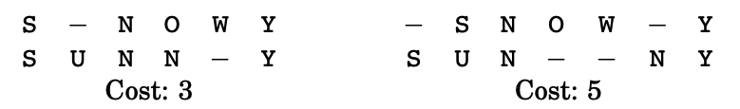
Edit Distance
A measurement of the alignment of two words to determine how many changes are necessary in order to turn one word into another. We try to match up letters that are equivalent in order to reduce the number of changes. For instance:
Fundamentally, this is an optimization problem, but one that can be solved using a dynamic programming approach.

Slide 13
Algorithm:
Function edit(x,y): Input: x and y, two strings of length m and n respectively Output: an integer representing edit distance between x and y
for i = 0,1,2,...,m: E(i,0) = i for j = 1,2,...n: E(0,j) = j for i=1,2,....m: for j=1,2,...n: E(i,j) = min{E(i-1,j)+1,E(i,j-1) + 1,E(i-1,j-1)+diff(i,j)} return E(m,n)
diff(i,j): if x[i] == y[j], return 0, otherwise return 1

Slide 14
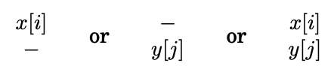
What’s going on here?
Basically, the algorithm builds a table, row by row, by looking at possible alignments:
We know the first two automatically mean that we incur a cost of 1. The third might incur a cost, but maybe not. This alignment building is reflected in this line:
E(i,j) = min{E(i-1,j)+1,E(i,j-1) + 1,E(i-1,j-1)+diff(i,j)}

Slide 15
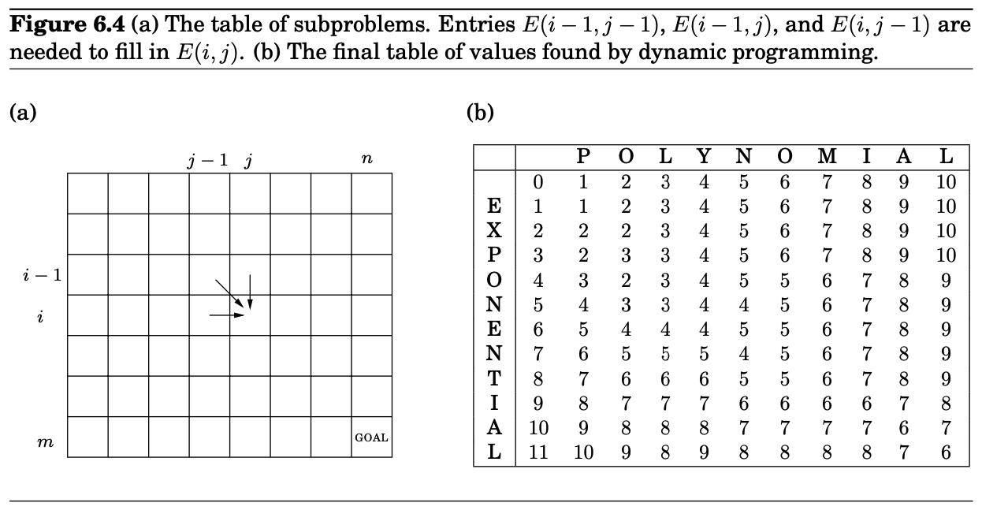
A visual?
Notes:
And - even better - we can trace the path from the top left to the bottom right to get how the words are aligned!

Slide 16
Example:
Let’s take a look at the SUNNY and SNOWY example from before.
TO THE GOOGLE SHEET!

Slide 17
Now you:
Run the edit distance algorithm on the following strings:
SLEEP SNOOPY
Build the table of subproblems like in figure 6.4 in the Dasgupta book.
Remote folks - when you have completed the task, send a discord message or just pop back in to the main room.

Slide 18
Knapsack
Another problem that fits nicely with dynamic programming!
Consider that you encounter a cache of buried treasure, free for the taking. But, you can only handle so much weight. What should you choose to maximize your profits? Let's assume that you can carry 100 pounds, and the items are:
Item | Weight | Value
1 | 60 | 3000
2 | 30 | 1400
3 | 40 | 1600
4 | 20 | 900

Slide 19
Two versions
There are two versions of the classic knapsack problem:
0-n knapsack, or knapsack without repetition
Knapsack with repetition
Both are NP-complete problems.
But, you say, the book says the dynamic programming solution is O(nW)? Isn’t that polynomial?
Nope, because the input size is proportional to the length of W, not the value of W.
Notes:
What is the input? n items, and a W that is a single integer. This expands due to W needing to be represented, in length, by the bit string length, not the integer string length.

Slide 20
Algorithm (with repetition):
Function: Knapsack(w, v, W): Input: a weight array w, a value array v, a maximum weight W Output: maximum value
K(0) = 0 for x = 1 to W: K(x) = max{K(x-w_i) + v_i for all w_i <= x} return K(W)
Nice and simple, yeah?

Slide 21
What’s going on here:
Builds a 1-D array of length W + 1 from left to right, by considering all possible items that could be added to that point.

Slide 22
Example

Slide 23
Now you:
Here’s the knapsack without repetition algorithm: Function: knapsack(w,v,W): Input: a weight array w, a value array v, a maximum capacity W Output: maximum value
Initialize all K(0,j) = 0, and all K(x,0) = 0 for j = 1 to n: for x = 1 to W: if w_j > x: K(x,j) = K(x, j-1) else: K(x,j) = max{K(x,j-1),K(x-w_j,j-1) + v_j} return K(W,n)
Use the previous example values and run this algorithm. Be prepared to talk us through it!

Slide 24
On your radar:
Homework #5: available now, due next week! Both problems require a dynamic programming solution.
Grade return target for Synthesis #2: November 15th
Self-selected final project group information due November 8th via email
Reading: Dasgupta, Chapter 7; Skiena, 16.6

Slide 25
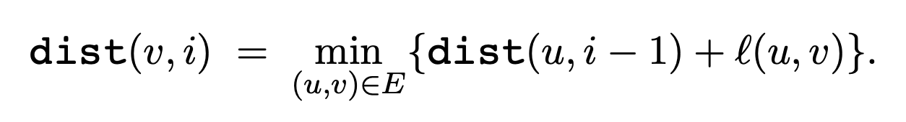
Last one: shortest paths (again)
Can we apply dynamic programming to the shortest path problem?
Yeah - consider what the subproblems should be. Basically, we should have (like with knapsack) a way to consider the shortest path that includes a particular vertex m. Something like:

Slide 26
Where do we go from here?
Based on our earlier update algorithm, we can consider the more general problem of all-pairs shortest path. Meaning, instead of focusing on a specific set of s and t, we want the shortest path from each vertex to every other vertex in our graph.
Enter Floyd-Warshall, an O(|V|³) algorithm to calculate all-pairs shortest path.

Slide 27
function FW(G, l): Input: Graph G = (V,E) directed or undirected; edge lengths (l_e : e in E); Output: For all vertex pairs u,v in V, dist(u,v,w) is set to the shortest path distance from u to v using only vertices 1,...,w
n = |V|
for i = 1 to n: for j = 1 to n: dist(i,j,0) = inf
for all (i,j) in E: dist(i,j,0) = l(i,j)
for k = 1 to n: for i = 1 to n: for j = 1 to n: dist(i,j,k) = min{dist(i,k,k-1) + dist(k,j,k-1), dist(i,j,k-1)}

Slide 28
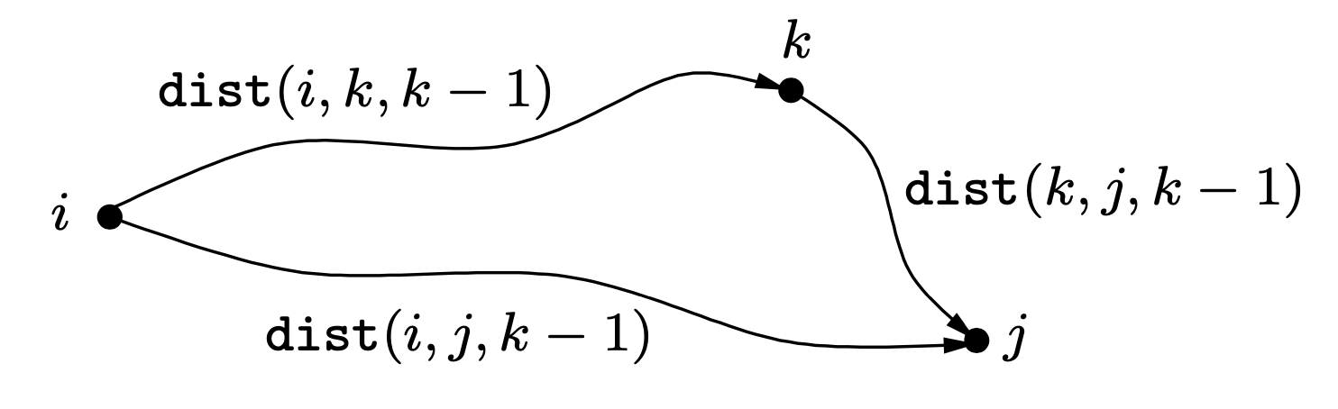
Basically:
We build out a table dist(i, j, k) where the entry gives us the shortest path from i to j using vertices 1...k as possible intermediate vertices along the path from i to j.
One assumption we are making: no negative cost cycles so each shortest path will include a vertex at most once.

Slide 29
Example:
As you’d expect, this is a bit complicated to show as an example, but there are nice visualizations out there.
https://www.cs.usfca.edu/~galles/visualization/Floyd.html
The neat thing about this visualization is that it shows that we can actually do this by using just two distinct tables, one that takes care of the path route, and one that takes care of updating cost.
Why can we do this? If we proceed in order (considering 0 then 1 and so on) as intermediate vertices then we can note that, for instance, getting from i to 1 may include 0, but that was captured in an earlier iteration!

Slide 30
A design exercise:
Dasgupta 6.17
Given an unlimited supply of coins of denominations x₁, x₂, … , x_{n}, we wish to make change for a value v; that is, we wish to find a set of coins whose total value is v. This might not be possible: for instance, if the denominations are 5 and 10 then we can make change for 15 but not for 12. Give an O(nv) dynamic programming algorithm for the following problem.
Input: x₁, x₂, … , x_{n}; v. Question: Is it possible to make change for v using coins of denominations x₁, x₂, … , x_{n}?

